Slide 1
IS-95A Fuzzy Handoff Algorithm Review
“A Novel Soft Handoff Algorithm for Fair Network Resources Distribution” by B. AliPanahi, M. Karzand

Slide 2
Interim Standard 95 (IS-95)
Focus of “A Novel Soft Handoff Algorithm for Fair Network Resources Distribution” is on the IS-95 handoff (transition) procedure of mobile devices (MS) moving in and out of basestation (BTS) cells.
IS-95 was the first Code Division Multiple Access (CDMA) cellular network standard, known as cdmaOne, deployed in 1995. Later revisions became IS-2000 known as CDMA2000, a popular 3G technology in the early 2000’s.
This paper proposed a Fuzzy Inference Engine (FIS) to improve network resource sharing when performing “soft” handoffs.

Slide 3
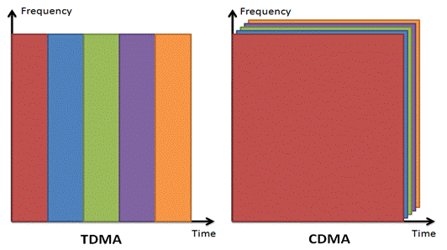
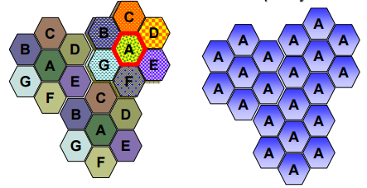
Code Division Multiple Access (CDMA)
Multiple access schemes are used by networks to support multiple separate control and traffic channels with constrained resources
Frequency Division Multiple Access (FDMA), ex Radio
Time Division Multiple Access (TDMA), ex GSM
Code Division Multiple Access (CDMA), ex. IS-95
Spatial Division Multiple Access (SDMA), ex. 802.11ad
CDMA overlays multiple channels on the same frequency range but “spreads” their energy using pseudorandom noise sequences known as PN codes or PRN codes. This allows receivers to pull a desired signal out of the noise by correlating against a specific code.
http://www.ni.com/tutorial/7107/en/
http://www.pitt.edu/~dtipper/2720/2720_Slides9.pdf

Slide 4
IS-95 Call Setup
Mobile device (MS) searches for Basestations (BTS) by measuring Received Signal Strength (RSS) of Pilot channel
Decode BTS Synch channel, synch timing with BTS
Register with BTS using Reverse Access Channel (RACH)
Monitor BTS Paging channel for response, information
Originate call with BTS using RACH
Monitor BTS Paging channel for Traffic Channel assignment
Carry out call on Traffic channel
Detect BTS
Register
Monitor
End Call
Request Traffic Channel
Accept Call
In Call
Notes:
From perspective of the mobile device

Slide 5
IS-95 Call Handoff
Process of switching Traffic Channel usage between multiple BTS as the mobile device moves in/out of coverage during a call.
Hard Handoff - break connection and re-initiate with new BTS.
Soft Handoff - using CDMA, and RAKE receivers, each mobile device can use multiple channels from multiple BTS simultaneously (multipath from 1 BTS = multi-channel from > 1 BTS)
Each mobile device maintains 3 groups of BTS pilot channels
Active Set - pilot channels associated with traffic channels currently being used by this MS
Candidate Set - pilot channels that would be in the Active set if it wasn’t full
Neighbor Set - pilot channels in the Neighbor List of a BTS in the Active Set.
Each mobile device maintains 2 thresholds and a timer for each pilot channel
T_ADD - threshold RSS needed to add the pilot to the Active or Candidate Set
T_DROP - threshold RSS that determines when the timer is started
T_TDROP - timer that determines when a pilot is removed from the Active or Candidate Sets.
Notes:
So instead of just having 1 channel at any given time, it maintains multiple sets of channels

Slide 6
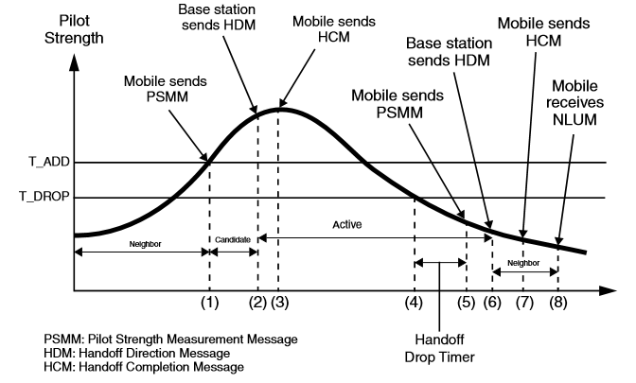
http://catalogue.pearsoned.co.uk/samplechapter/0130871125.pdf

Slide 7
More Features
Selective Soft Handoff (Selective SHO)
When an Active Set pilot’s RSS is greater than T_SEL dB for T_TADD seconds, then don’t add anymore channels to the Active Set until it dips back below T_SEL. This prevents a mobile device from hogging more good channels than it needs.
Hysteresis Condition
Only add a 3rd and 4th pilot to the Active Set if they are DELTA dB more than the other Active Set pilots RSS. This further ensures that mobile devices don’t reserve more resources unless they are significantly better than what they are already using.
Notes:
I didn’t implement this logic in the simulation since they didn’t assign values for these parameters. I wouldn’t be hard to pick some, but I didn’t have time to implement.

Slide 8
Handoff Fuzzy Inference System (FIS)
Inputs
Number of BTS in current MS Active Set (NOBS)
Number of BTS free channels remaining (CHRM)
Outputs
Drop Threshold (T_DROP)
Soft Handoff Window (SHW)
Minimum Inference Engine (MIE) with Centroid of Average (COA) Defuzzification
Causes each MS to update their T_ADD, T_DROP thresholds as the inputs change
T_ADD = T_DROP + SHW

Slide 9
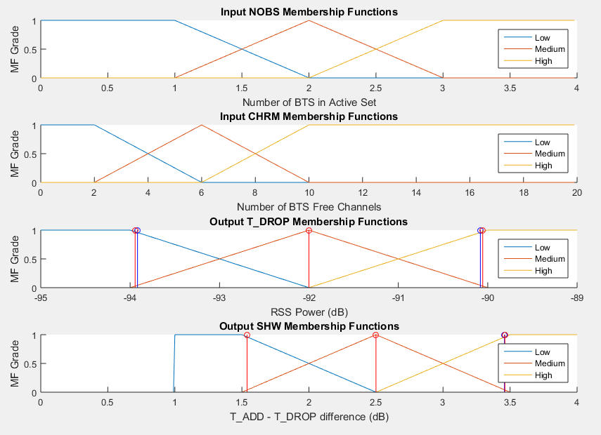
Membership Functions
SHW output can’t = 0 or else T_DROP would = T_ADD, that’s why it’s low end is a trapezoid that cuts off at 1.
COA vs. CA didn’t make much difference (due to triangle MF’s). Blue stems are CA centers and Red stems are COA centers.

Slide 10
Fuzzy Rules
T_DROP |  | CHRM
 |  | LOW | MEDIUM | HIGH
NOBS | LOW | HIGH | MEDIUM | LOW
 | MEDIUM | HIGH | MEDIUM | LOW
 | HIGH | HIGH | HIGH | MEDIUM
Rule 1: If NOBS is Low and CHRM is Low then T_DROP and SHW are High
Rules are identical for both outputs, leading to 9 total rules.
Author chose min/max composition, but minimum vs. product didn’t seem to make a difference in output.
SHW |  | CHRM
 |  | LOW | MEDIUM | HIGH
NOBS | LOW | HIGH | MEDIUM | LOW
 | MEDIUM | HIGH | MEDIUM | LOW
 | HIGH | HIGH | HIGH | MEDIUM

Slide 11
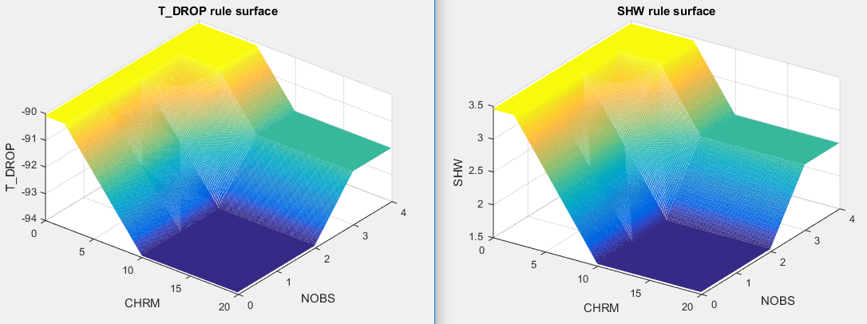
Rule Surface
Notes:
I wrote a test script that produced all this output, MIE is it’s own matlab function. All these outputs match what’s in the paper.

Slide 12
Simulation Model
Radio Propagation Model
RSS = K1 – K2 * log(d) + S
K1 = 0, K2 = 30 and are constants dependent on BTS power/environment
d = distance from MS to BTS
S = zero-mean Gaussian shadowing effect w/ std deviation of 6.5
Traffic Model
Call arrival is Poisson process with mean arrival = 6
Calls arrive uniformly over simulation area
Call duration is exponential process with mean = 120 seconds
Mobility Model
Velocity of MS is Gaussian, mean = 6, std deviation = 10, output capped at 16 m/s
Direction of MS is uniformly distributed between 0 – 360 degrees
Both updated every 10s
Cell Model
19 Cells, 1 km radius for each cell, omni-direction antenna, 20 traffic channels supported per BTS
4 channels in MS Active Set, 5 channels in MS Candidate Set

Slide 13
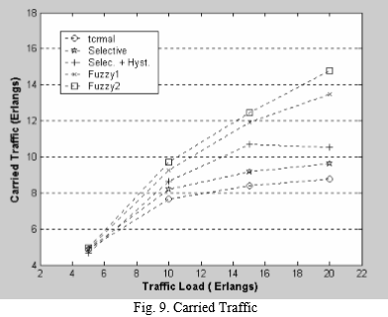
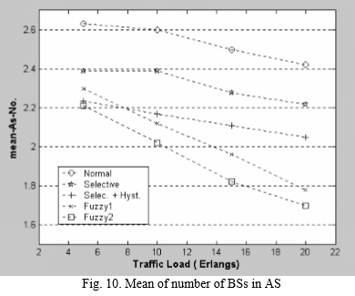
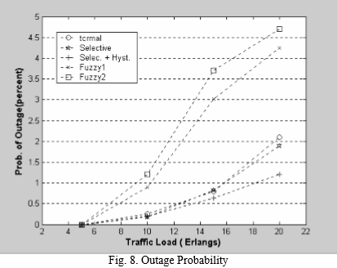
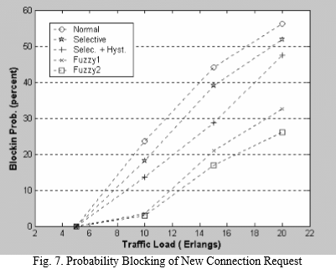
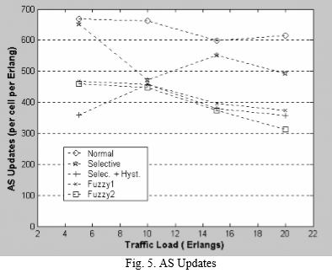
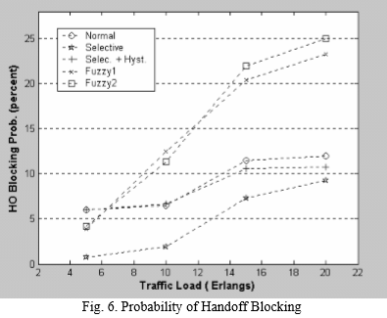
Results

Slide 14
Simulation
1) BTS channel (pilot) RSS
FIS
4) New T_ADD
New T_DROP
MS channel eval
(AS, CS, NS bookkeeping)
2) BTS channel decision
(add, drop, blocked)
Simulation Model Updates
3) New Active Set*
New number of free channels**
* Not clear if average # of active set for BTS, or this MS
** Not clear if number of free channels is global or this BTS

Slide 15
Issues with the paper
References to the Active Set having 4 or 6 BTS
Chose 4 based on membership function input space shown
No value of T_TDROP timer
I chose 5 seconds, with 10s velocity/direction update in mind
RSS calculation resulted in abnormal power levels ~200 dB, that don’t match the membership function output space
Chose calculation based on other literature that produces more realistic results
Wasn’t clear whether the FIS input, remaining free channels, was per BTS or the global value; or whether each MS was to maintain a separate T_ADD, T_DROP for each BTS
Decided to keep 1 T_ADD, T_DROP per MS and use the global free channels
Wasn’t able to figure out how Erlang traffic load is measured/created
Produced metrics based on instantaneous load at each time step and averages over entire simulation
Unclear metrics like “cell outage”

Slide 16
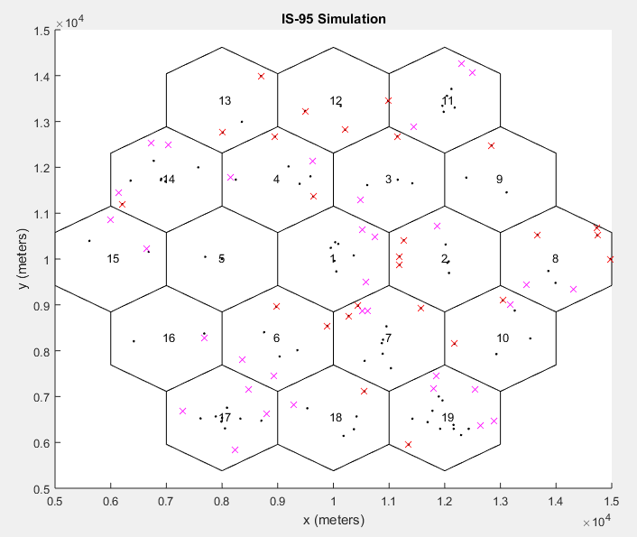
Using ~paper parameters
T_ADD -90
T_DROP -100
Total calls = 100
Blocked calls = 26
Dropped calls = 33
Handoffs = 0
RSS spread over a cell radius is much greater than the ~2 dB used in the FIS, creates a “dead zone”
MS don’t move fast enough to make it through “dead zone” to a new cell before being dropped.
Notes:
The issue is power levels. With a T_ADD of -90, any call out of range will be blocked and any that moves out of range will be dropped. -90 dB doesn’t extend to the edge of each cell, so there’s a large outage area. T_ADD should really be at least the expected power level at the cell radius, and really should overlap with the neighboring cells. This way there’s actually room for handoffs…. But the paper doesn’t address power levels and the RSS equation and values don’t seem to work for the simulation.

Slide 17
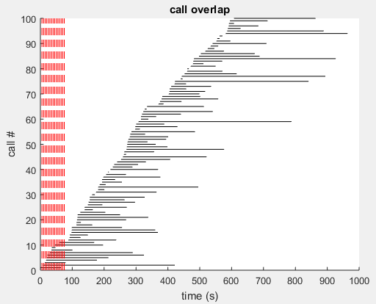
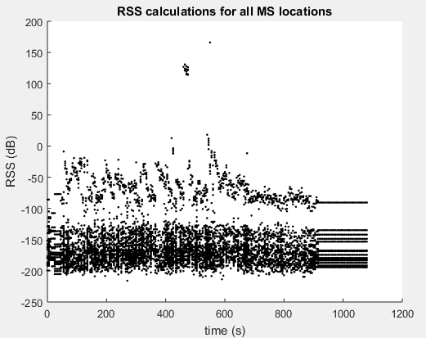
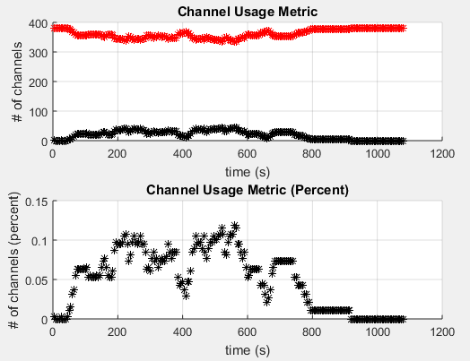
More graphs

Slide 18
Better Numbers
Static
T_ADD = -110
T_DROP = -120
Total calls = 100
Blocked calls = 3
Dropped calls = 10
Handoffs = 5
Blocked handoffs = 31
Channels per BTS = 10*
w/ Fuzzy
T_ADD = [-126, -95]
T_DROP = [-125, -105]
Total calls = 100
Blocked calls = 3
Dropped calls = 17
Handoffs = 8
Blocked handoffs = 35
Channels per BTS = 10*
Heavy Load
T_ADD = [-126, -95]
T_DROP = [-125, -105]
Total calls = 100
Blocked calls = 22
Dropped calls = 14
Handoffs = 9
Blocked handoffs = 255
Channels per BTS = 10*
Call arrival mean = .6**
* To try to force more activity, would need more traffic otherwise. FIS input CHRM is pegged at 10 channels anyway, so it doesn’t change outputs
** Paper used 6, the lower the number the heavier the call traffic
Notes:
Pick better numbers so the simulation works, lower T_ADD, T_DROP, less channels if I need to show handoffs

Slide 19
Simulation
See separate mp4 files.

Slide 20
Summary
T_DROP and T_ADD parameters must be chosen based on the range of RSS possible within a cell. IMO they should be close to the RSS value at the edge of a cell so that there is overlap between cells where mobile devices qualify for multiple BTS and the Fuzzy Logic controller can have an impact.
I’m not sure how the author had so much difference in the results that were percentages over increased load, when the FIS output only varies by ~2 dB. The RSS calculation is key – my power range was drastically different over the radius of a cell from 10’s to almost 100 dB.
Some metrics that sounded clear, aren’t when you go to implement the simulation
What exact state does the author count as a cell outage? This could be lack of understanding IS-95 protocol.
Wasn’t clear whether the T_ADD, SHW parameters controlled by FIS were to be updated globally for all channel determinations or separately for each mobile device/BTS.
Simulation TODO
Each MS should check each BTS channel RSS with random noise/fading when doing Set maintainance. I take a shortcut by only calculating RSS for 1 channel per BTS and assuming the channels per BTS are the same. This means if a mobile is using more than 1 channel from the same BTS, they will all be added/dropped/handoff together which prevents spatial diversity and can essentially force hard handoff.
Add Selective and Hysteresis features
Move channel bookkeeping into function

Slide 21

Questions

